Slide 1
Lab #04
CLAUSES

Slide 2
Objective
To understand and implement different clauses using wampserver

Slide 3
Clauses
In databases, clauses are special components of SQL (Structured Query Language) statements.
They define conditions, limits, sorting, grouping, and other rules applied to queries

Slide 4
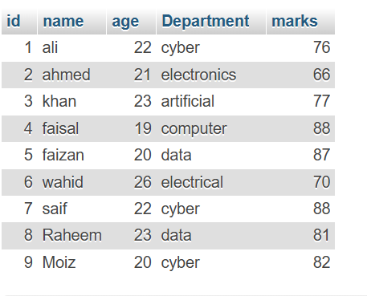

Slide 5
Where Clause
SELECT * FROM stable WHERE Age > 19;

Slide 6
Order by Clause
SELECT * FROM Stable ORDER BY Marks DESC;

Slide 7
GROUP BY Clause
SELECT Department, COUNT(*) FROM stable GROUP BY Department;
Groups by department and counts students in each.

Slide 8
HAVING Clause
SELECT Department, COUNT(*) FROM stable GROUP BY Department HAVING COUNT(*) > 1;
Shows only departments with more than 1 student.

Slide 9
FROM Clause
SELECT Name, Marks FROM stable;

Slide 10
LIMIT Clause
SELECT * FROM stable LIMIT 3;
SELECT * FROM stable LIMIT 0, 2;
SELECT * FROM stable LIMIT 2, 3;

